Slide 1
Ames, iowa
House prices prediction

Slide 2

Model Workflow
Exploratory Data Analysis (EDA)
Featuring Exploration
Feature Selection
Model Evaluation
Areas For Improvement

Slide 3
Model Approaches
Simple and clean
Robust and in-depth

Slide 4

Exploratory Data Analysis (EDA)
Look for Data completeness
Fixed missing data
Removed corrupted rows
Reshaping of data for usability
Convert Years into ages
Turning Y/N into 1/0
Identifying outliers
Determine whether to keep or remove, and for which category

Slide 5
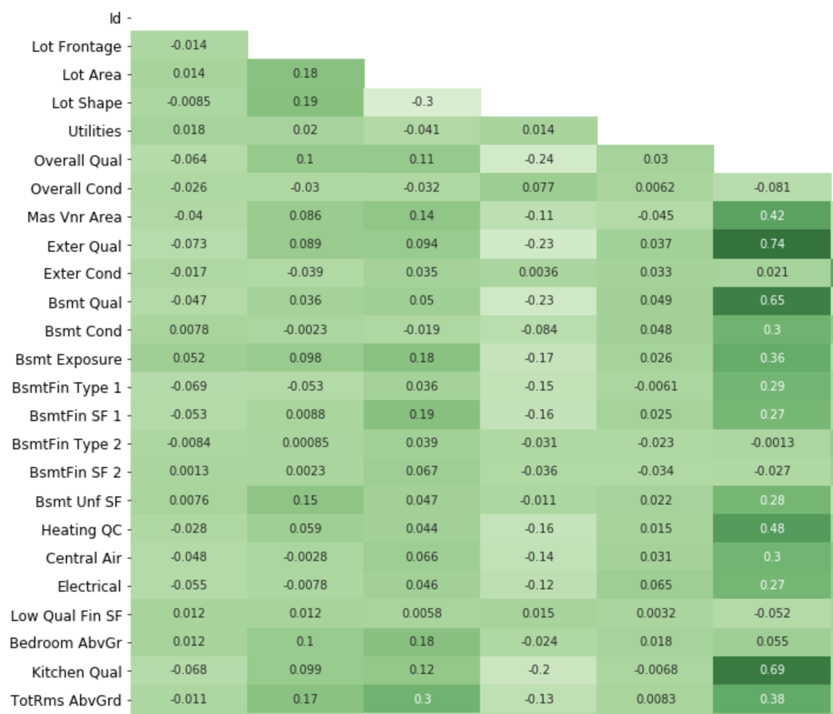
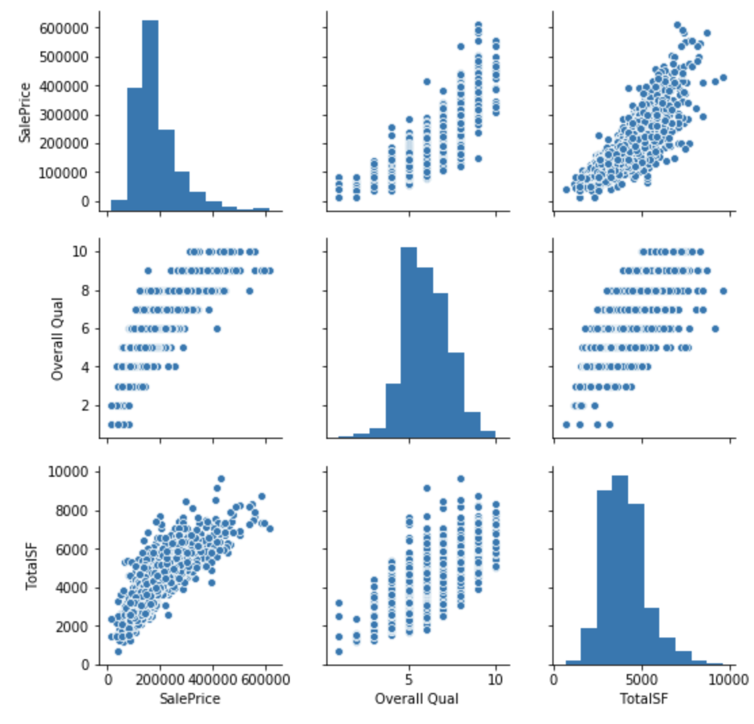
Feature Exploration - Ginn
Heat Mapping and PairPlots to visualise correlations and distribution between the features.
Heatmap
Pairplot

Slide 6
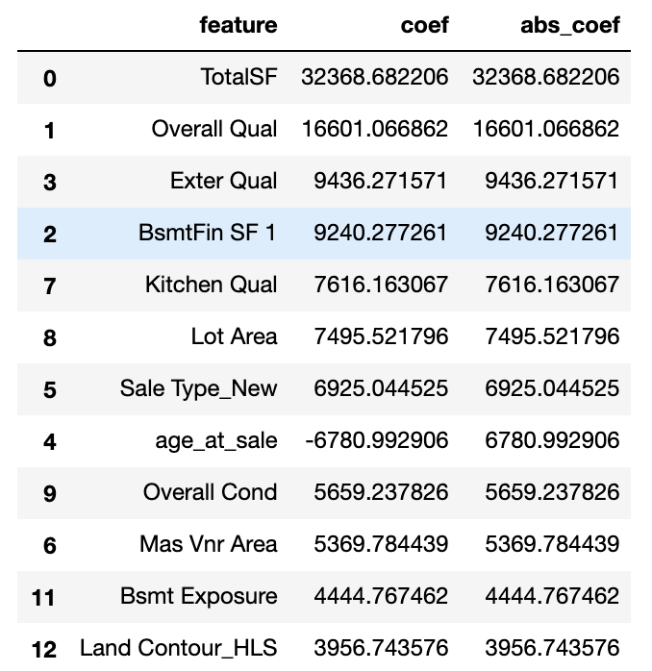
Feature selection - Ginn
Features selection
Elimination Process
Lasso: Highest Coefficient

Slide 7
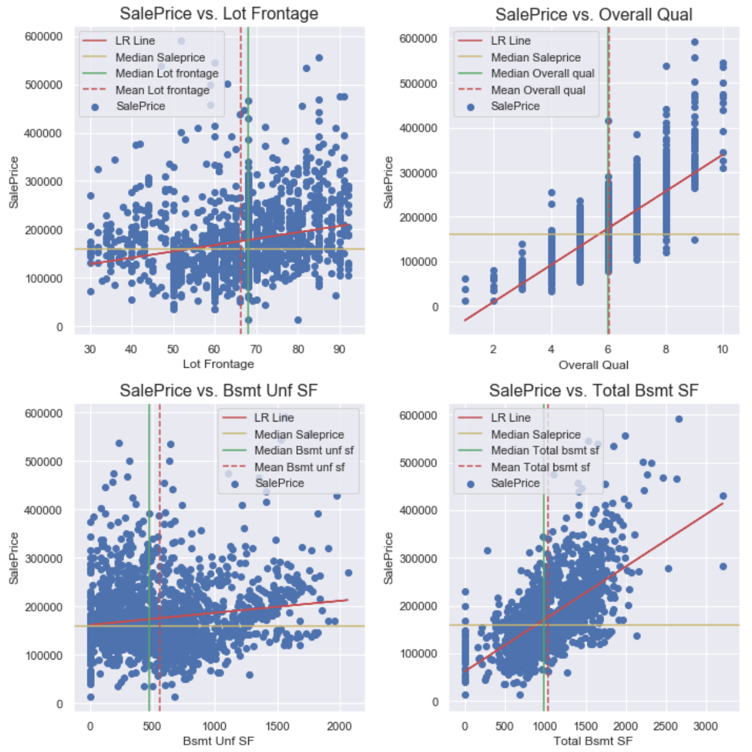
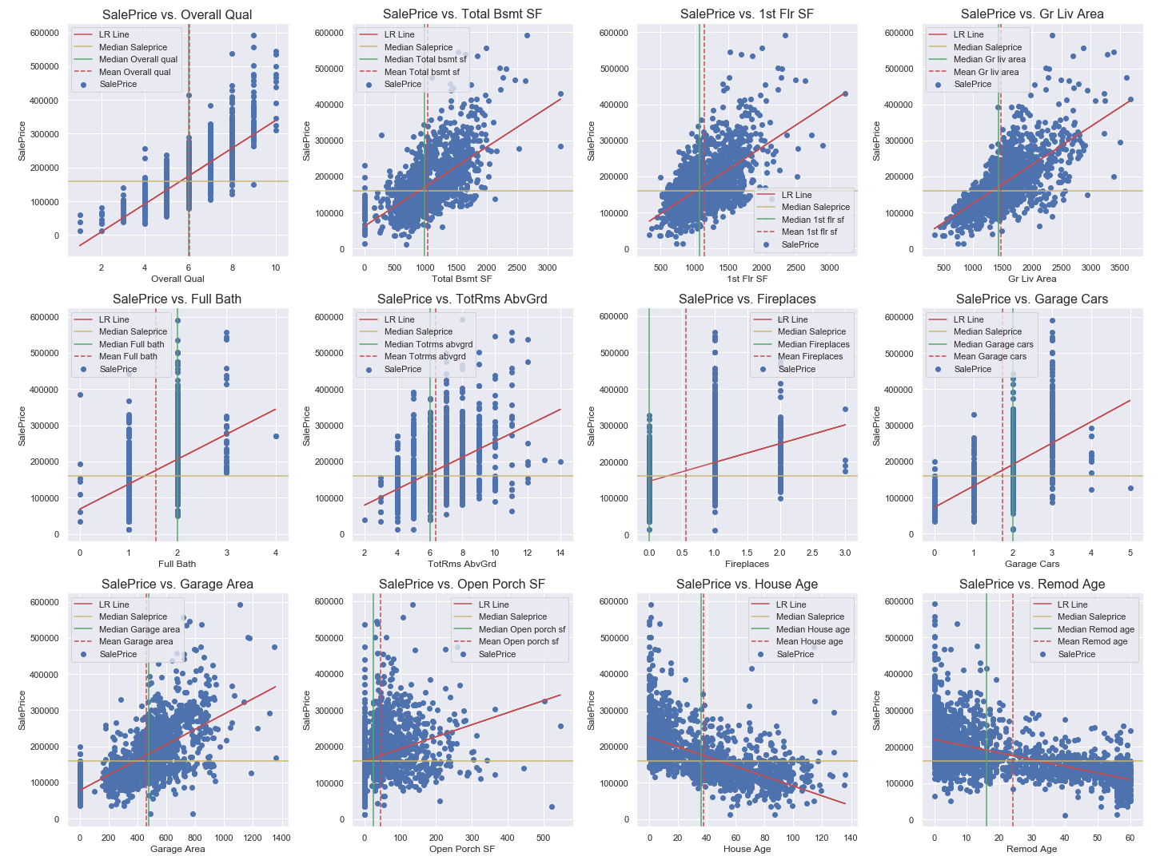
Feature Exploration & Selection - Alfred
Identifying linear relationships and retaining features with strong relationships.
Before elimination
After elimination

Slide 8
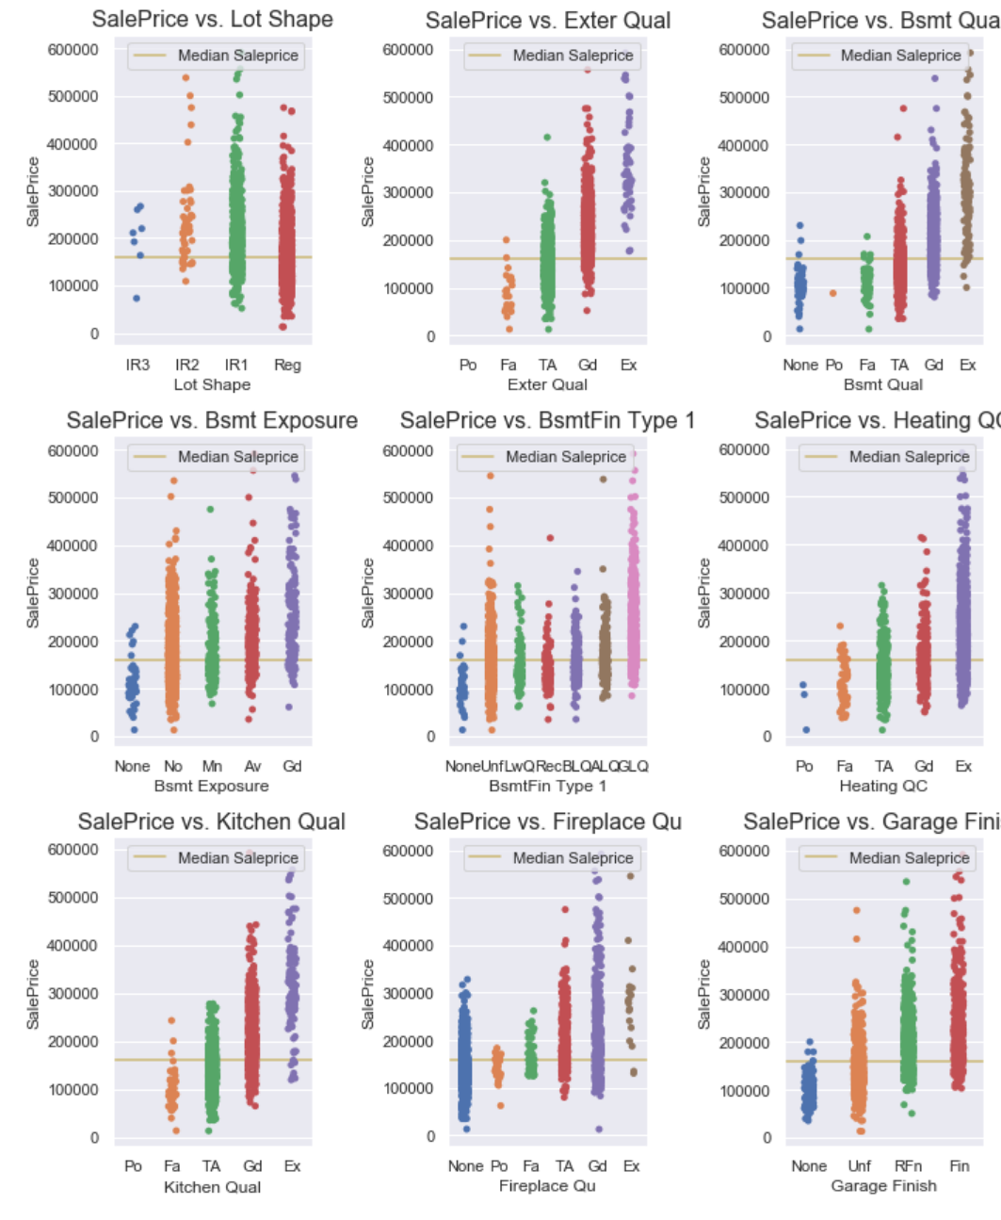
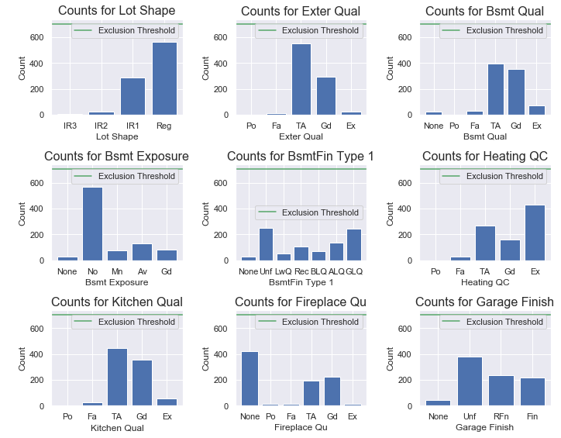
Feature Exploration & Selection - Alfred
Selection and exploration of Ordinal data and their relationship to Sale Price.
Selection of Ordinal data
Strip Plot: Sale Price vs Ordinal Data

Slide 9
Model Evaluation - Ginn
Train Test Split
Separate portion of data as a control group to access model performance
Scaling and Transform
Convert numeric values to Standard Deviation for selected features
Regularisation
Lasso reduces predictive coefficient to zero and help to separate features
Assessment
Test Model using Cross validation Scoring
Comparing of R2 Sores of training and test data to assessment the model

Slide 10
Model Evaluation - Alfred
Modelling: Iterative approach
Cross-validation: Use all remaining features to generate baseline scores for predictive model
Perform Recursive Feature Elimination to identify important features by rank
Use RFE features to create a model for generating predictions from test set
Compare post- and pre-RFE models' scores to assess whether the RFE model is an improved one
Generate list of RFE features and create business recommendations

Slide 11
Model Evaluation - Ginn
Top 12 Model Coefficients
R2 Score on Test Prediction
0.881
Train RMSE
34848

Slide 12
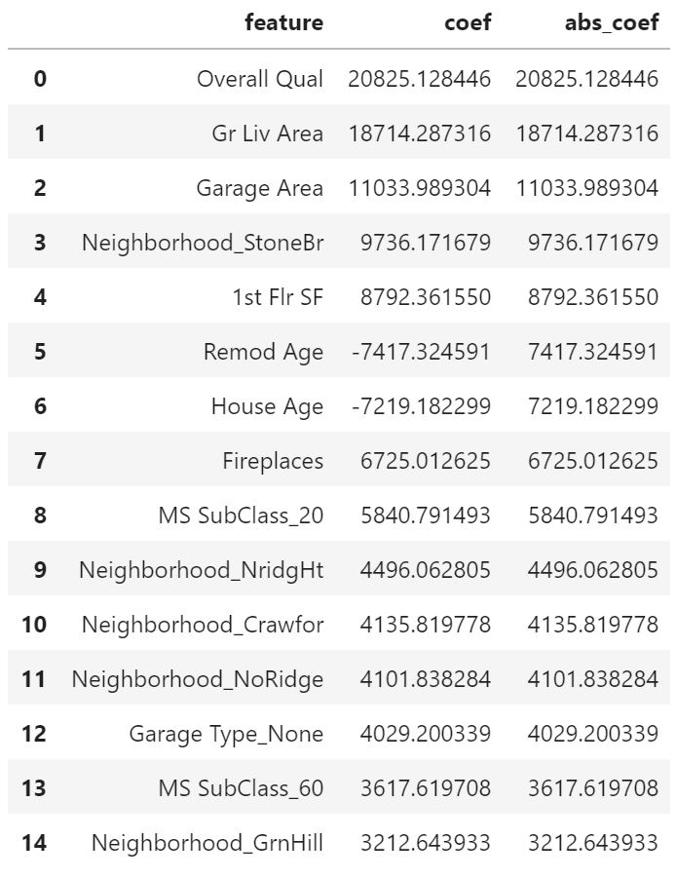
Model Evaluation - Alfred
Top 15 Model Features

Slide 13
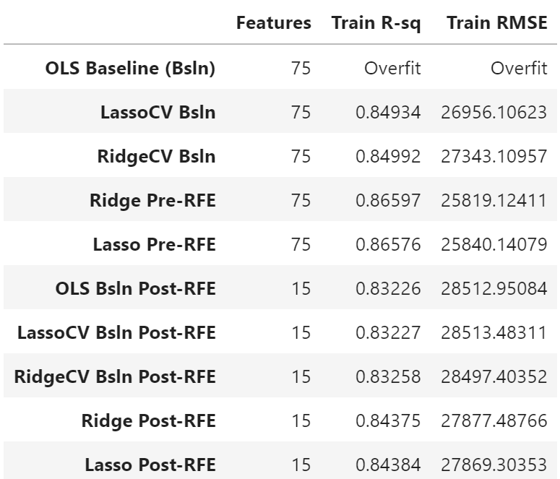
Model Evaluation - Alfred
Top 15 Model Coefficients
R2 Score on Test Prediction
0.844
Train RMSE
27869

Slide 14
Areas for improvement
Impute missing data more effectively
Reduce impact of zeroing missing data
Increase domain knowledge by consulting domain veterans
Dealing with outliers
Explore methods other than dropping rows:
replace value with median for the neighbourhood, for example?
Utilise GridSearch to search for the optimal set of parameters and tune the model

Slide 15

Q&A

